Slide 1
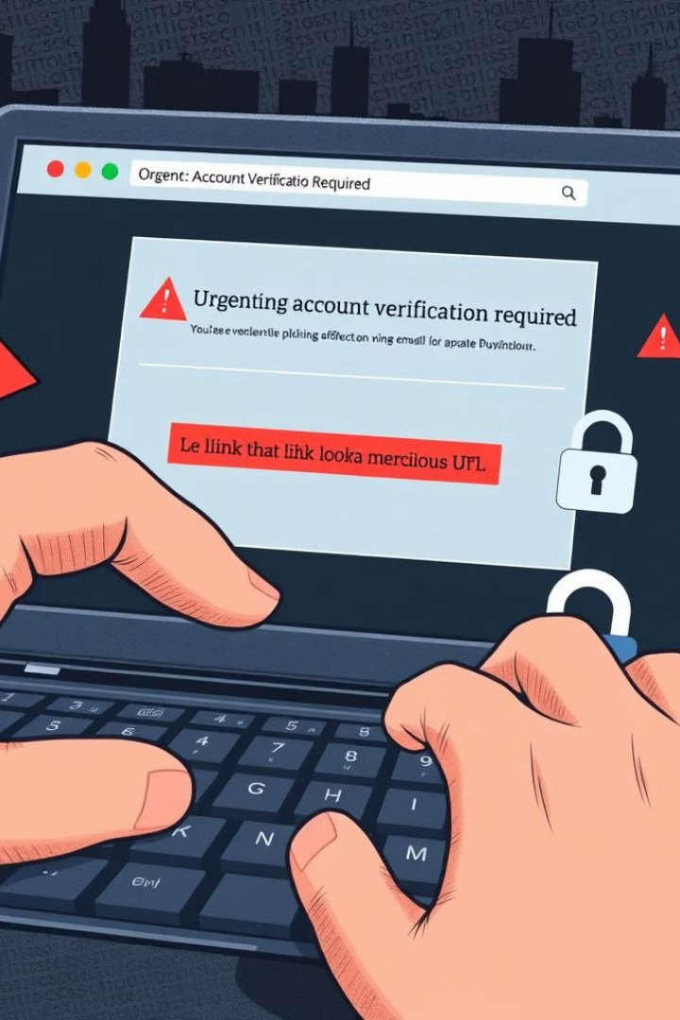
Phishing Awareness
Phishing is a dangerous cybercrime where attackers use deceptive emails, websites, or messages to trick victims into revealing sensitive information or taking harmful actions. Understanding the techniques and how to identify phishing attempts is crucial for protecting oneself.

Slide 2

What is Phishing?
Manipulation Tactics
Phishing relies on social engineering to manipulate victims into disclosing login credentials, financial information, or other sensitive data.
Deceptive Techniques
Phishing emails or websites often mimic legitimate sources to appear trustworthy, such as banks, companies, or government agencies.
Malicious Intent
The goal of phishing is to steal personal information or infect devices with malware for financial gain or other malicious purposes.

Slide 3
Phishing Techniques
Email Phishing
Fake emails that appear to be from trusted sources, often containing malicious links or attachments.
Smishing
Phishing attempts via text messages, using similar tactics to email phishing.
Vishing
Phishing via phone calls, where attackers impersonate legitimate organizations to obtain sensitive information.

Slide 4

Identifying Phishing Attempts
Sender Address
Look for inconsistencies or unfamiliar email addresses that don't match the claimed sender.
Suspicious Links
Hover over links to check if the URL matches the claimed destination.
Urgent Tone
Phishing emails often use a sense of urgency to pressure victims into taking action.
Generic Greetings
Legitimate messages typically address the recipient by name, not just "Dear customer".

Slide 5
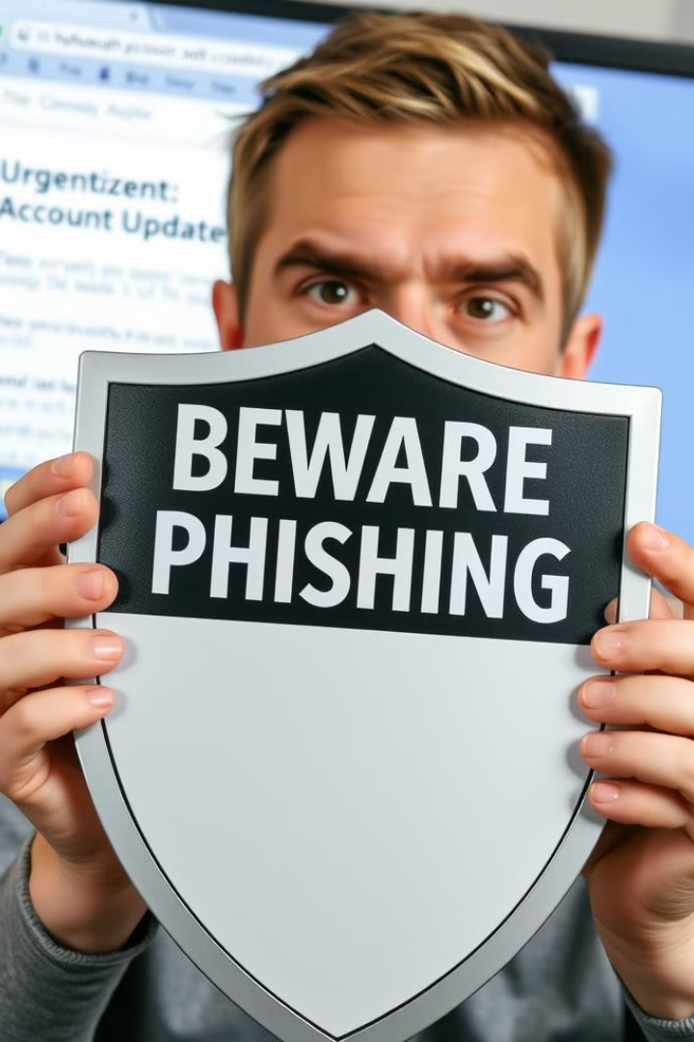
Protecting Yourself from Phishing
Verify Source
Carefully inspect the email, message, or website to ensure it is legitimate before taking any action.
Enable Security
Use antivirus software, firewalls, and email filtering to block and detect phishing attempts.
Educate Yourself
Stay informed about the latest phishing tactics and best practices for online safety.

Slide 6

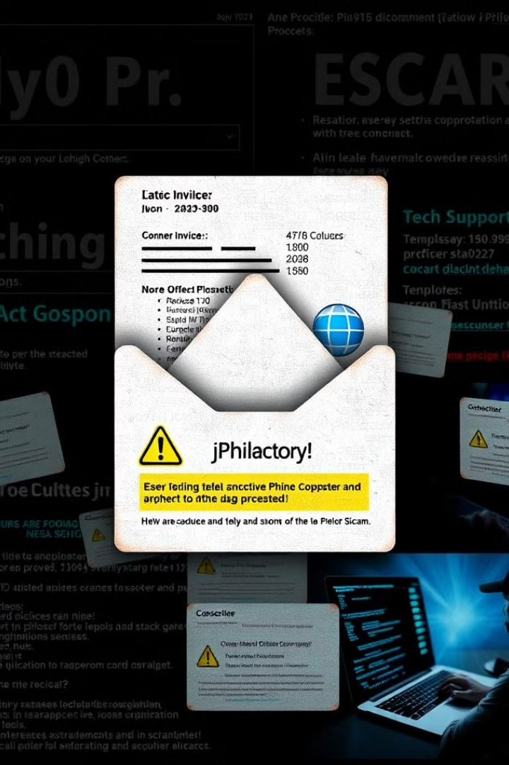


Phishing Scams to Watch Out For
Fake Invoices
Phishers may send invoices for fake products or services to trick victims into making payments.
Lottery Scams
Victims are notified of a fictional lottery win and asked to pay fees or provide personal information.
Tech Support Scams
Attackers pose as tech support representatives to gain access to devices and steal data.

Slide 7

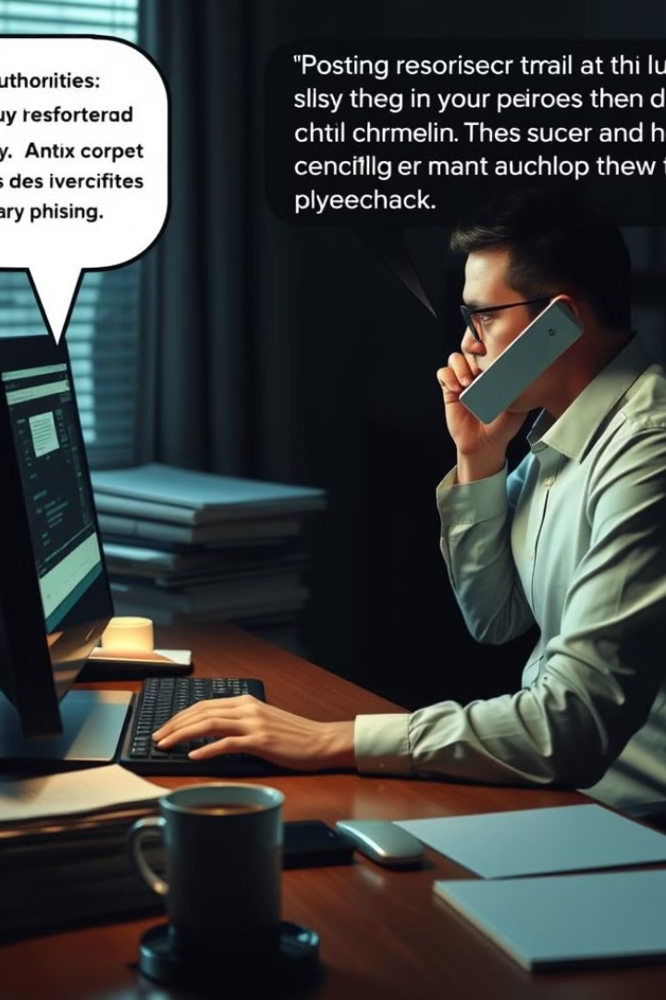


Reporting Phishing Attempts
Identify
Recognize the phishing attempt and gather relevant information, such as the sender's email address.
Report
Notify the appropriate authorities, such as your email provider or the Federal Trade Commission.
Prevent
Help stop the spread of phishing by educating others and continuing to be vigilant.

Slide 8
Importance of Cybersecurity Awareness
Personal Protection
Staying informed about phishing and other cyber threats helps individuals safeguard their personal information and assets.
Organizational Security
Employees who are cybersecurity-aware can help protect their company's systems and data from phishing attacks.
Societal Impact
Widespread cybersecurity awareness can reduce the overall impact of phishing and other cyber crimes on communities and economies.

Slide 9
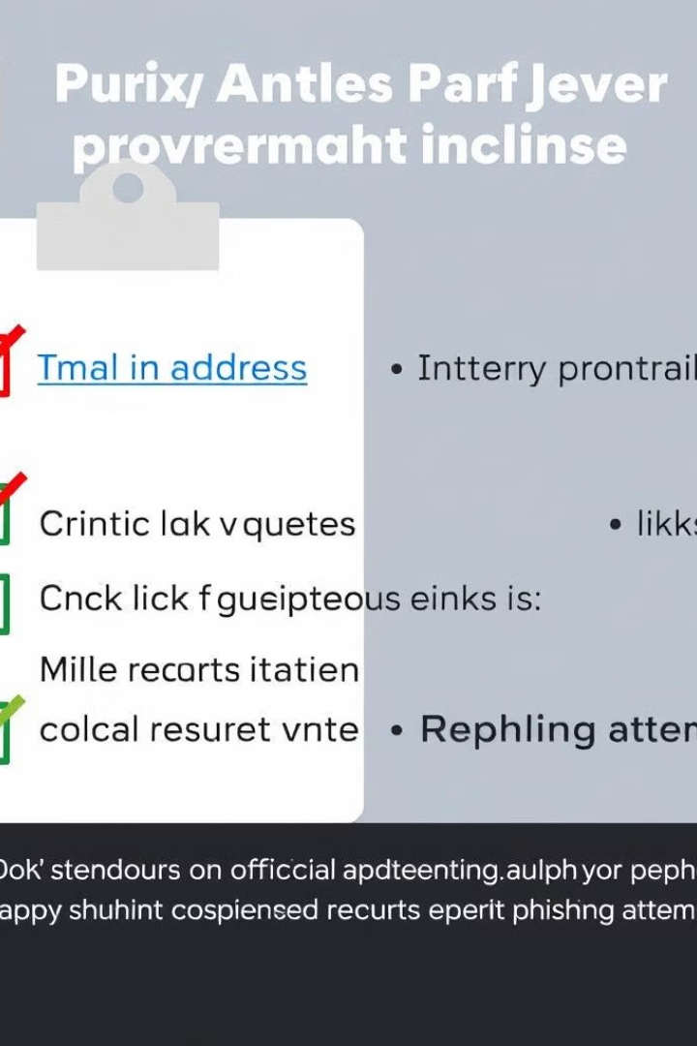
Best Practices for Phishing Prevention
Use strong, unique passwords
Enable two-factor
authentication
Be cautious of unsolicited messages
Verify website URLs and email addresses
Keep software and devices updated
Report suspicious activity promptly

Slide 10

Conclusion and Key Takeaways
Vigilance is Key
Continuous Learning
Collective Responsibility
Staying alert and recognizing phishing attempts is crucial for protecting oneself and others.
Regularly updating cybersecurity knowledge and best practices is essential in the ever-evolving landscape of phishing threats.
By educating ourselves and reporting phishing attempts, we can collectively help to combat this widespread cybercrime.

